Slide 1
MYTHILI D
3 YR B.E COMPUTER SCIENCE
REG: 211521104093

Slide 2
USING GAN TO GENERATE CHEST X-RAY IMAGES
LET’S INDULGE THROUGH AI

Slide 3
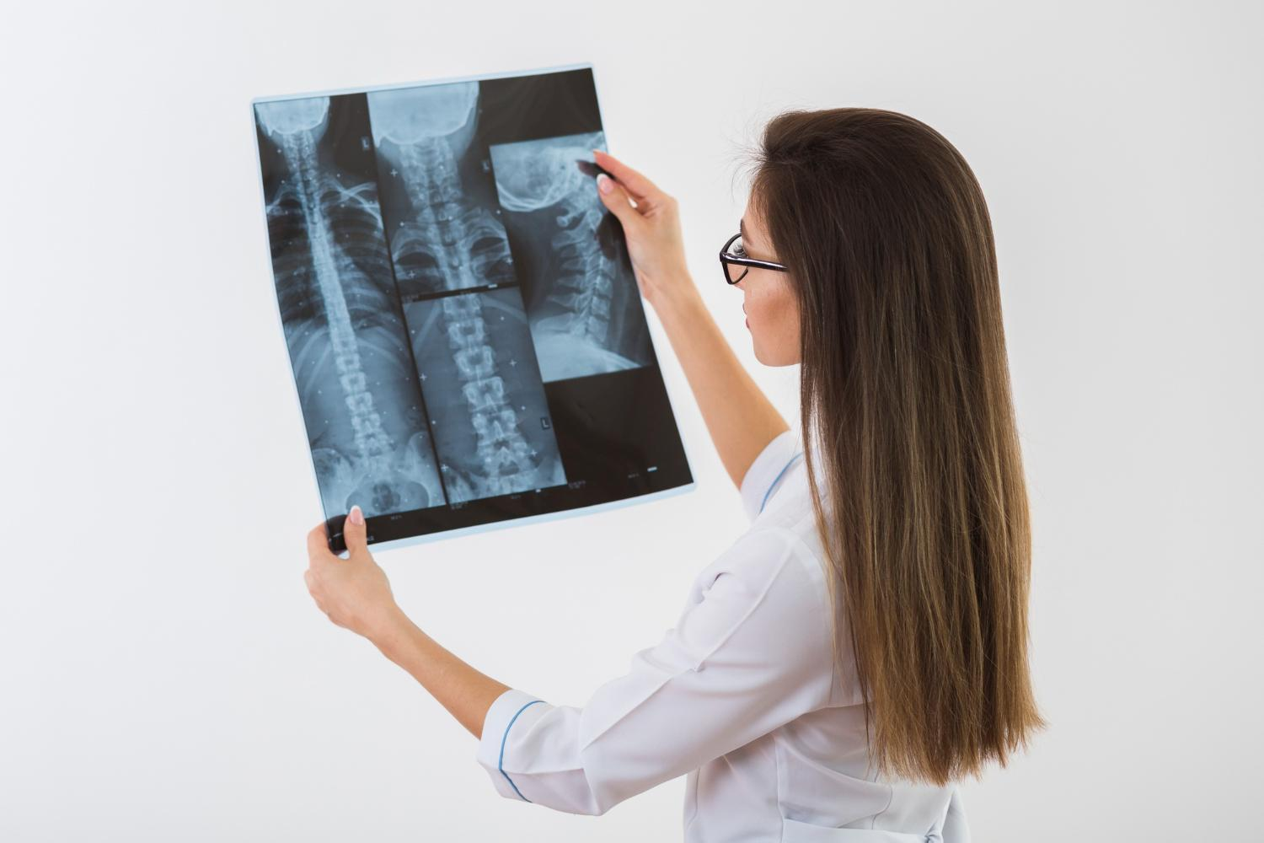
AGENDA

Slide 4
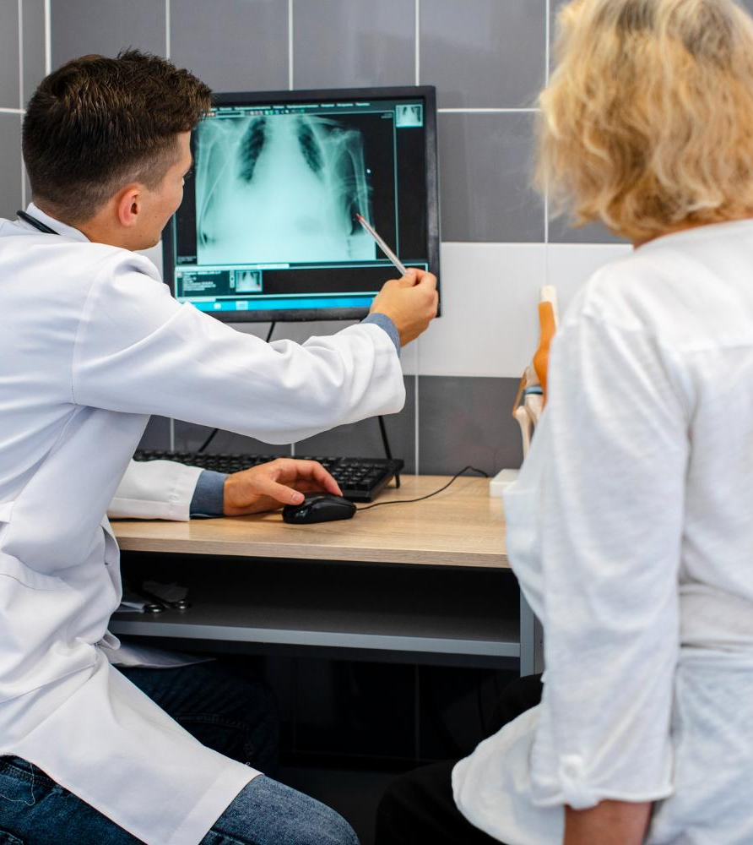
AGENDA OF THE TOPIC
1.Understand GANs: Gain a solid understanding of Generative Adversarial Networks (GANs), including their architecture, training process, and applications in image generation tasks.
2.Dataset Preparation: Collect and preprocess a dataset of AI character images, ensuring consistency, quality, and suitability for training GAN models.
3.Model Selection: Choose an appropriate GAN architecture (e.g., DCGAN, StyleGAN) based on project requirements, dataset characteristics, and computational resources available.

Slide 5
4.Implementation: Code the selected GAN architecture, including the generator and discriminator networks, loss functions, and optimization algorithms, using TensorFlow or PyTorch.
5.Training: Split the dataset into training and validation sets, and train the GAN model to generate realistic images of AI characters' faces. Monitor training progress, adjust hyperparameters if necessary, and ensure convergence.
6.Evaluation: Evaluate the generated images for visual quality, diversity, and realism. Gather feedback from peers and stakeholders to assess the model's performance and identify areas for improvement.

Slide 6
7.Fine-tuning and Refinement: Fine-tune the GAN model based on evaluation results, experimenting with techniques to improve image quality, diversity, and avoid mode collapse. Apply post-processing techniques to refine the generated images.
8.Documentation and Best Practices: Document the entire process, including dataset collection, model implementation, training, evaluation, and refinement. Document best practices, challenges faced, and lessons learned during the project.
9.Presentation and Communication: Prepare a presentation or documentation to communicate the project outcomes, including the generated images, evaluation results, and insights gained, to stakeholders and peers.
10.Future Work: Identify potential areas for future research or application, such as extending the project to generate images of different AI characters or exploring other image generation techniques beyond GANs.

Slide 7
PROBLEM STATEMENT
Problem statement
Expected outcome
The task is to generate realistic and diverse images of AI character faces using Generative Adversarial Networks (GANs). The objective is to create a dataset of AI character faces that are visually appealing, diverse, and suitable for various applications such as gaming, animation, virtual assistants, and digital art.
The expected outcome is a well-trained GAN model capable of generating high-quality and diverse images of AI character faces. The generated dataset and model can be utilized in various applications to enhance user experiences and facilitate creative endeavors in the domain of artificial intelligence and digital entertainment.

Slide 8
PROJECT OVERVIEW
The generation of images of AI characters' faces using Generative Adversarial Networks (GANs) combines techniques from artificial intelligence (AI), machine learning, and computer vision to create novel visual representations of fictional or existing AI characters. This topic addresses the challenge of synthesizing realistic and diverse images of AI characters, which are commonly found in various media such as movies, video games, and literature.

Slide 9
END USERS
1.Entertainment Industry Professionals: Production studios, game developers, and content creators may use AI-generated images of characters' faces to enhance storytelling, create concept art, design characters, and generate visual effects in movies, video games, animations, and virtual reality experiences.
2.Artists and Designers: Graphic designers, illustrators, and digital artists may utilize AI-generated character images as inspiration for their creative works, character design explorations, or as assets for graphic design projects, advertisements, and marketing campaigns.
3.AI Researchers and Developers: Researchers and developers in the field of artificial intelligence may utilize AI-generated images of characters' faces for training and evaluating AI models related to computer vision, facial recognition, emotion recognition, and character animation.
4.Educators and Researchers: Academics, educators, and researchers may use AI-generated character images for educational purposes, such as teaching about AI, machine learning, computer graphics, and digital media production techniques.

Slide 10

5.Content Creators and Influencers: Content creators, social media influencers, and online personalities may incorporate AI-generated character images into their content, including videos, artwork, animations, and social media posts, to engage their audience and enhance their storytelling capabilities.
6.Virtual Reality (VR) and Augmented Reality (AR) Developers: Developers working in VR and AR applications may leverage AI-generated character images to create immersive experiences, virtual avatars, interactive storytelling, and character-driven simulations.
7.Creative Professionals and Hobbyists: Individuals with a passion for creativity, storytelling, and digital art may explore AI-generated character images as a source of inspiration and experimentation for personal projects, hobbyist endeavors, and creative expressions.
Overall, the end users of this topic span a wide range of industries, professions, and interests, reflecting the diverse applications and potential impact of AI-generated character images across various domains.

Slide 11
SOLUTION AND IT’S VALUE PROPOSITION

Slide 12
The solution for generating images of AI characters' faces using GANs involves implementing and training a GAN model on a dataset of AI character images. By selecting an appropriate GAN architecture, preprocessing the dataset, and fine-tuning the training process, realistic and diverse images of AI characters' faces can be generated. The proposition lies in the application of these generated images across entertainment, AI research, digital media production, and creative endeavors, providing valuable assets for storytelling, character design, AI model training, educational materials, and immersive experiences in virtual and augmented reality.

Slide 13
THE WOW IN MY SOLUTION

Slide 14
The "wow" solution for generating images of AI characters' faces using GANs would involve creating a sophisticated AI model that not only accurately captures the unique features and characteristics of AI characters but also allows for interactive customization and real-time generation. This solution could incorporate advanced GAN architectures, such as StyleGAN or Progressive GAN, coupled with powerful training techniques, data augmentation strategies, and fine-tuning mechanisms to achieve unparalleled realism and diversity in the generated images. Additionally, integrating user-friendly interfaces or tools for intuitive manipulation and customization of AI character attributes, such as facial expressions, hairstyles, clothing, and personalities, would further enhance the wow factor of the solution. Imagine being able to effortlessly create and customize lifelike AI characters for various purposes, ranging from entertainment and gaming to virtual companionship and personalized storytelling, revolutionizing the way we interact with and perceive artificial intelligence in visual media.

Slide 15
MODELING
DATA COLLECTION AND PREPROCESSING
CHOICE OF GAN ARCHITECTURE
MODEL IMPLEMENTATION
TRAINING
EVALUATION
REFINEMENT AND OPTIMIZATION
DEPLOYMENT AND USE
DOCUMENTATION AND MAINTENANCE

Slide 16
RESULT
The result of generating images of AI characters' faces using GANs is the creation of realistic and diverse visual representations of fictional or existing AI characters. Through the application of advanced deep learning techniques and training methodologies, the GAN model produces high-quality images that closely resemble AI characters from various sources such as movies, video games, or artwork. These generated images can be utilized across industries and domains, including entertainment production, digital media creation, AI research, virtual reality experiences, and creative projects. The result represents a significant advancement in the field of artificial intelligence and computer graphics, enabling new possibilities for storytelling, character design, and immersive experiences involving AI-driven visual content.

Slide 17
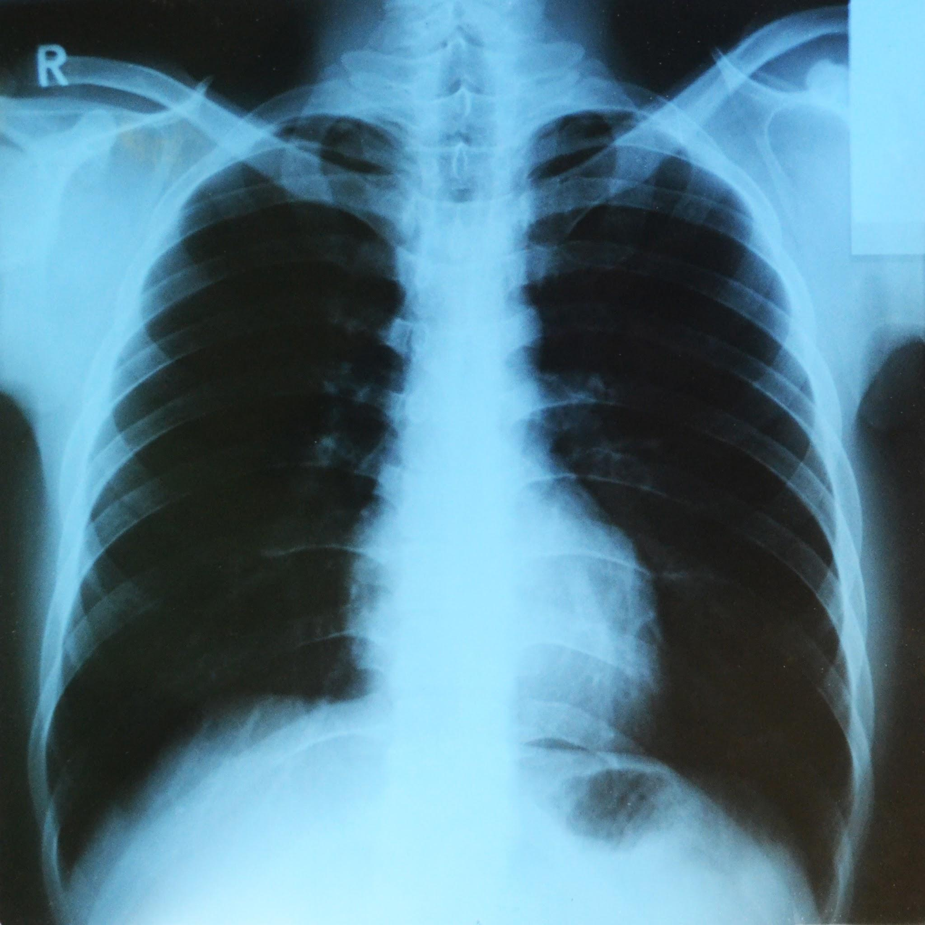
THANKYOU!

